Slide 1

Predicting US Graduate Program Admission using User Profiles from Edulix.com
Group 31: Shloak Aggarwal 2017107
Syed Ali Abbas Rizvi 2017114
Tanish Jain 2017115

Slide 2
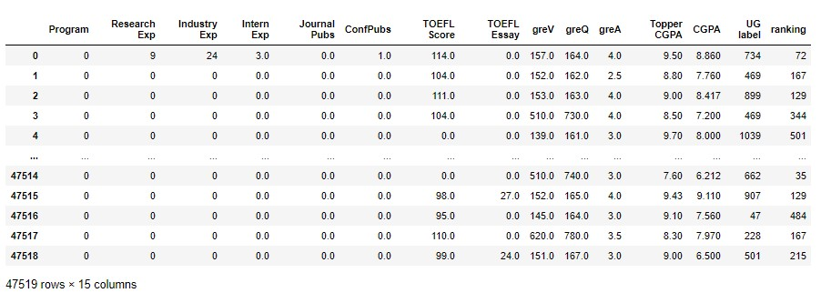
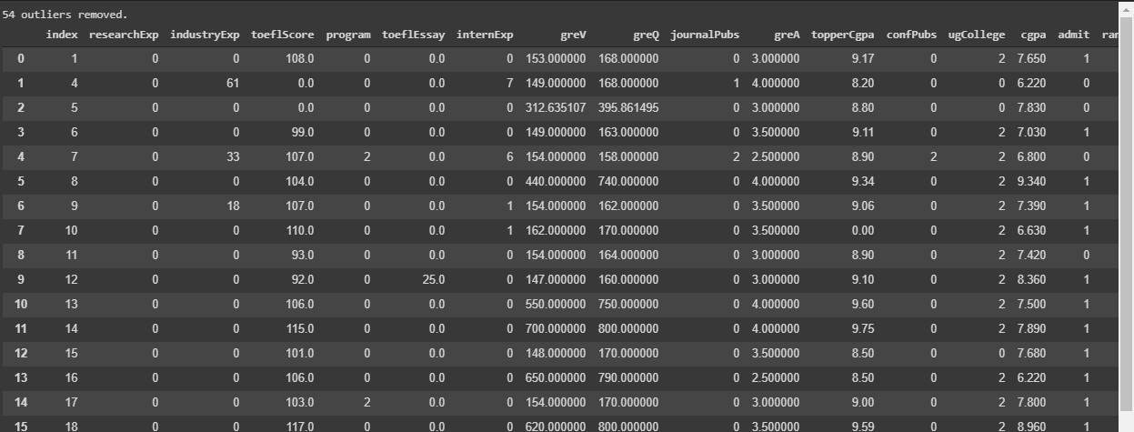
Data (Source: GitHub + Edulix.com)

Slide 3
Data cleaning and preprocessing
Manually cleaned the data.
Dropping samples which had no value for at least 1 feature left us with almost no samples.
Using 15 of 26 columns. Discarded columns (after use): 'Username', 'Specialization', 'Major', 'Department', 'User Profile Link', 'Term & Year', 'gmatV', 'gmatQ', 'gmatA', ‘CGPA Scale’
Replaced all string entries with integer entries using LabelEncoder or simple hash functions.
Replaced the Universities, the students were wanting to take admission in, with their international ranks.
Used the range values were supposed to be in, to remove outliers. Also used Z-Score to remove some more outliers.

Slide 4
Data cleaning and preprocessing (Cont.)
Filled all the null values with 0 values, removed samples with 0 as their ‘CGPA Scale’, scaled the CGPA based on the entries in the ‘CGPA Scale’ column and then standardized some of the columns.
Replaced 0 ‘Topper CGPA’ with 9 and removed entries with CGPA less than 3, ‘Topper CGPA’ less than 5.5 or more than 10 in both cases.
Replaced 0 entries in greA, greV, greQ columns with the mean of the column.
Finally shuffled the whole data.
53643x26 ---preprocess----> 47519x15

Slide 5
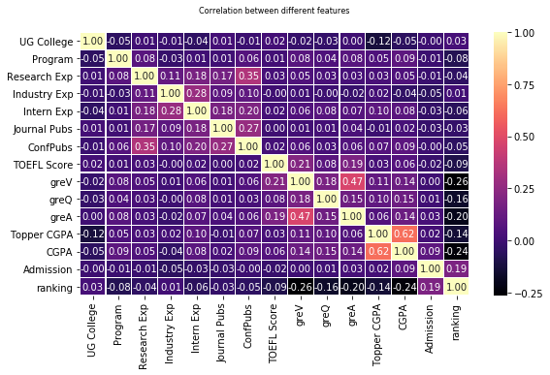
Heatmap

Slide 6
Heatmap
Observation:
Relatively high negative correlations between Ranking and greV, greQ, greA, and CGPA.
Means that the above-average students with higher CGPA and GRE scores are more inclined towards applying to the lower-integer i.e. better ranked universities.

Slide 7
Heatmap
Observation:
Relatively high positive correlation between Ranking and Admission
Lower ranked universities are more lenient about who they accept.

Slide 8
Heatmap
Observation:
Conference Publications has a high correlation with Research Experience

Slide 9
Heatmap
Observation:
greV has a high correlation with greQ, meaning that students who perform well in one section of the GRE are likely to perform well in the other.

Slide 10
Models Used
Logistic Regression with L1 regularisation
Logistic Regression with L2 regularisation
SVM with Poly Kernel, degree = 1
SVM with RBF Kernel
SVM with Linear Kernel
Random Forest Classifier with 10 trees
Random Forest Classifier with 15 trees
Random Forest Classifier with 1000 trees
Multilayer Perceptron (built using Tensorflow)
K Nearest Neighbours (2 neighbours)
K Nearest Neighbours (3 neighbours)
Multi-layer Perceptron (1000 iterations)
Multi-layer Perceptron (2000 iterations)
Bernoulli Naive Bayes
Complement Naive Bayes
Gaussian Naive Bayes
Multinomial Naive Bayes

Slide 11
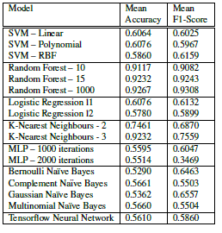
Final Accuracies & F1-Scores:

Slide 12
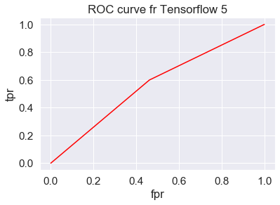
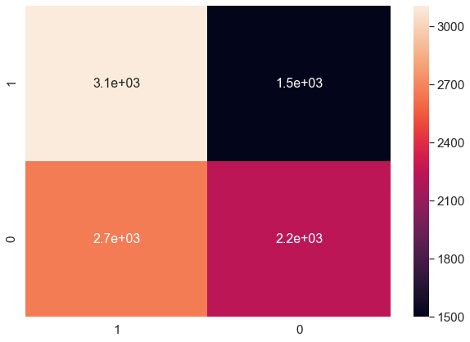
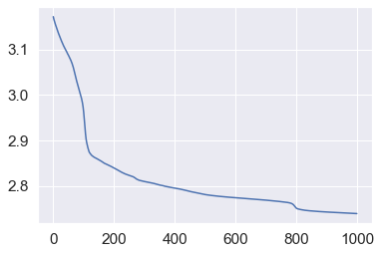
Neural Network created using Tensorflow
Custom made Neural Network
2 hidden layers with 30 and 45 neurons
Tanh activation on all hidden layers
Softmax on Output layer
Average accuracy = 0.56
Average f1-score = 0.5860
ROC Curve, Confusion Matrix and Cost vs Epoch graph respectively:

Slide 13
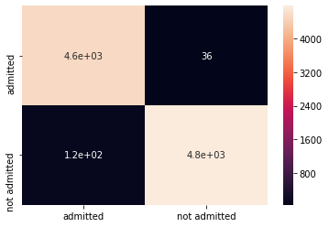

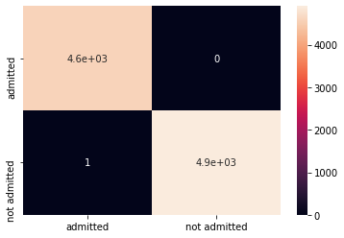
Confusion matrices of Random Forest Classifier with 10, 15 and 1000 trees respectively
Obtained test and train accuracies around 95%

Slide 14
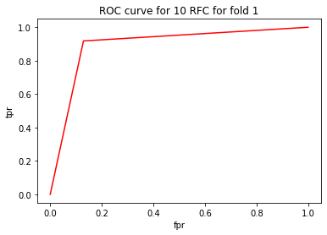
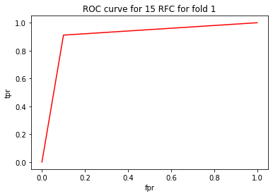
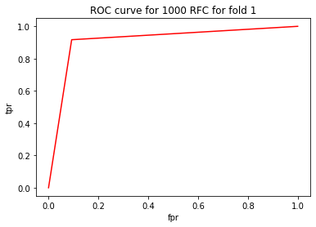
ROC Curves of Random Forest Classifiers with with 10, 15 and 1000 trees respectively
Giving test and train accuracies of around 95%

Slide 15
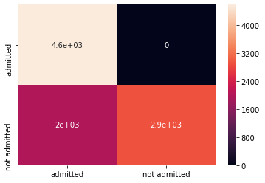
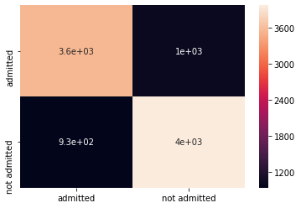
Confusion matrices of K Nearest Neighbour Classifiers with 2 and 3 neighbours respectively
Giving accuracies around 75 %

Slide 16
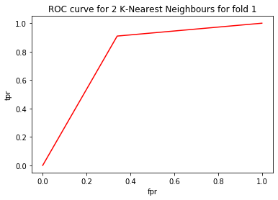
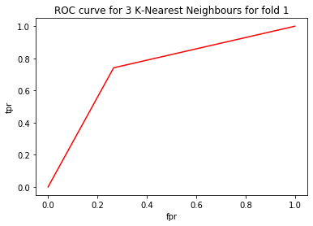
ROC Curves of K-Nearest Neighbours with 2 and 3 neighbours respectively
Giving testing and training accuracies around 75%

Slide 17
Conclusion
In most models, we obtained accuracies around 60\%, but using K-Nearest Neighbours we obtained accuracies around 75\%, and using Random Forest Classifier we obtained a very high accuracy of around 98\%.
The state-of-the-art accuracy that we came across is around 87\% for similar topics \cite{Waters}. In our study's data, the users who created profiles on Edulix.com did not fully fill all the fields in their profiles. As a result, out data was very sparse. Likewise, other researchers who did similar studies got a different number of samples after they did their own preprocessing.
In most cases, researchers seem to drop a lot of samples as the data is highly sparse. We, on the other hand, only dropped around 6000 samples out of the total 53600. This is why we obtained such high testing and training accuracy using random forest classifier and these accuracies didn't change much even if we changed the number of trees from 10 or 15 to 1000. For the other models, the accuracies remained near 50 to 60\% even after the parameters were varied greatly.

